Slide 1
DIGITAL TRANSFORMATION SYSTEM FOR ‘PRE-FAILURE ALERT GENERATION FOR EQUIPMENT FAILURE & COBBLE REDUCTION BASED ON DATA ANALYTICS AND VIDEO ANALYTICS’
At
Bar & Rod Mill,
Bhilai Steel Plant
Steel Authority of India Limited

Slide 2
Industry- Institute collaboration between
Bhilai Steel Plant,
Steel Authority of India Limited
&
Indian Institute of Technology, Bhilai

Slide 3
Bar & Rod Mill, BSP

Slide 5
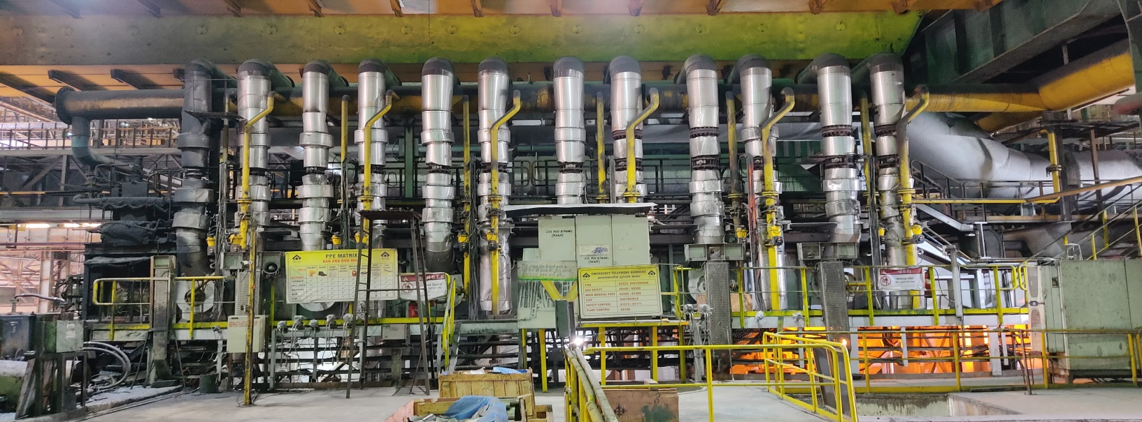

Slide 6
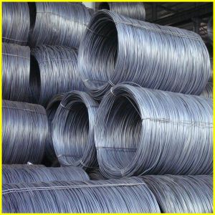
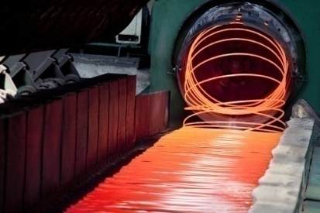
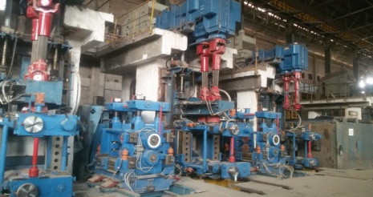
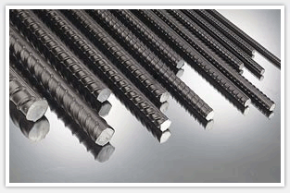
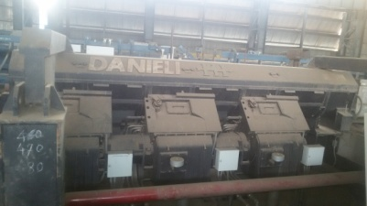
Mill Configuration
COIL HANDLING
& DISCHARGE
8-STAND
BLOCK
4-STAND
BLOCK/TMB
LAYING
HEAD
COOLING
CONVEYOR
ROD OUTLET (5.5-22mm)
(8-40mm)
6-STAND
BLOCK
WATER
BOXES
REHEATING
FURNACE
18 Nos.
STANDS
BAR OUTLETS
COOLING
BED
COLD
SHEAR
BUNDLING
& BINDING
(16-60mm)
(8-40mm)
BUNDLE
DISCHARGE
6-STAND
BLOCK
WATER
BOXES

Slide 7
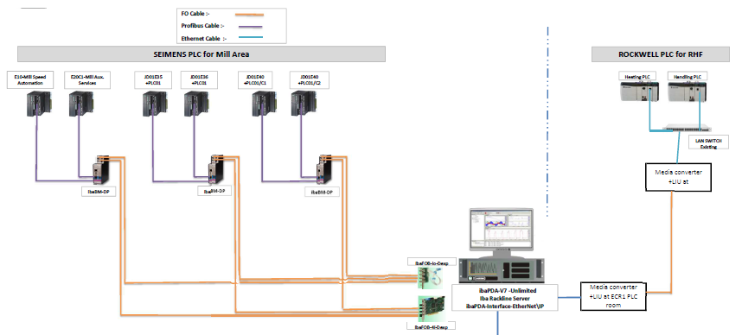
Existing analytical system at BRM prior to the project
iBa Data analytics system

Slide 8
Need for the DX Project

Slide 10
OUR AIM:

Slide 11
Milestone roadmap and timeline
OCTOBER 2023
MARCH 2024
JUNE 2024
OCTOBER 2024
MARCH 2025
JUNE 2025
Milestone 1
Milestone 2
Milestone 3
Milestone 4
Milestone 5
Milestone 6
Overview of solution
Offline PLC and Video analysis system
Online PLC data based pre-failure alerting system
System of real-time alerting on dog house video and PLC data
System for alerting using High-Speed Camera feeds
System for alerting using Thermal Camera feeds
Delivered on:
NOVEMBER 2023
MAY 2024
NOVEMBER 2024
FEBRUARY 2025

Slide 12
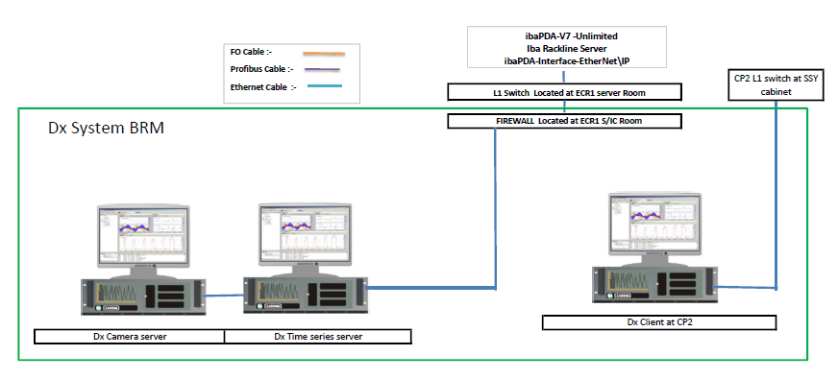
DX Architecture

Slide 13
DATA FLOW
Data coming from IBA server
POSTGRES Database for temporary data storage
INFLUX Database (Time series database: 1 year data)
ML Process(Finding patterns in data, csv upload, model training)
GRAFANA Dashboard (For visualisation)

Slide 14
Video architecture scheme for cameras

Slide 15
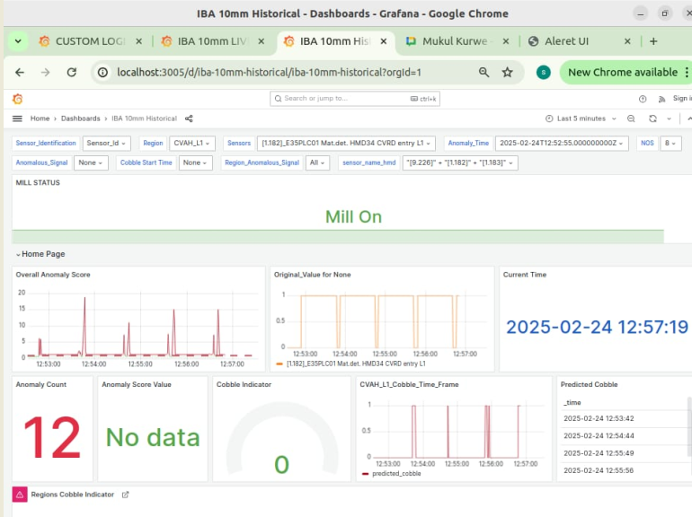
Grafana dashboard

Slide 16
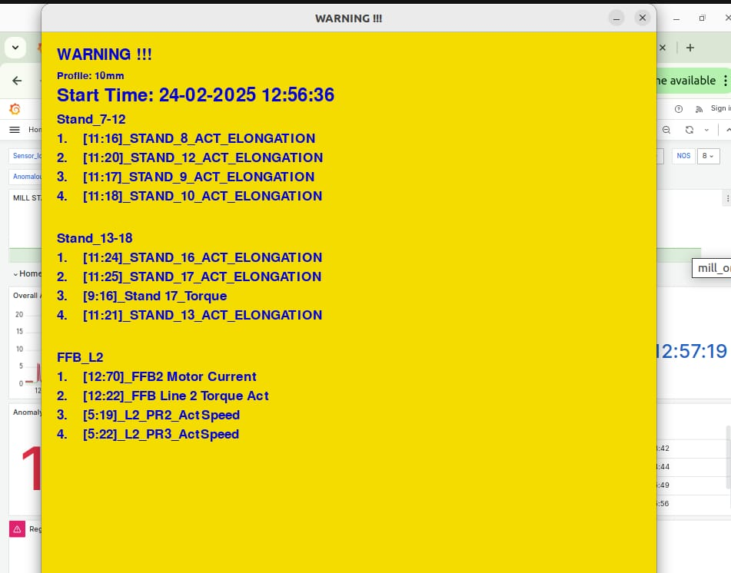
Alert pop up (Showing top 4 signals with highest anomaly scores)

Slide 17
User Interface for Control Pulpit

Slide 18
UI: pop up alert with sound

Slide 19
Custom logic for HMDs
Billet Head Tracking at Furnace Exit
In this, the difference between the times when billet head is sensed by desailer exit and when the billet head is sensed by roller table exit is tracked.
If this time exceeds, alert is generated as it can cause the next billet to be too close to the current billet

Slide 20
Custom logic for HMDs

Slide 21
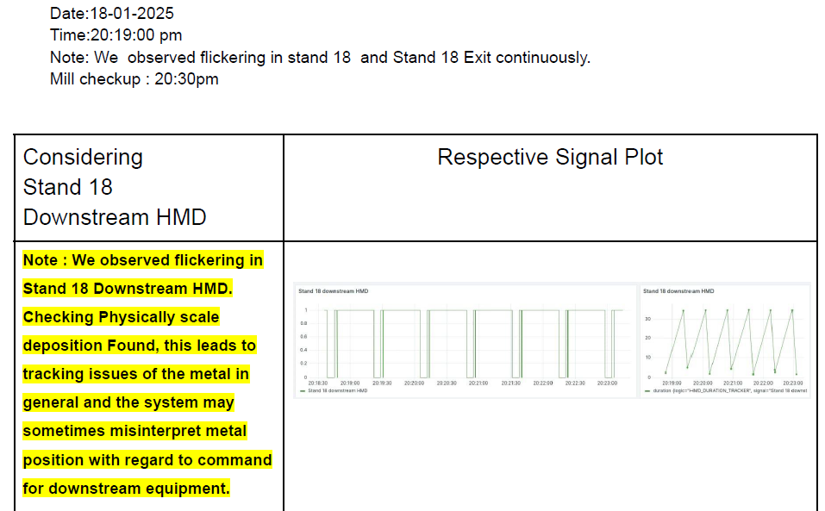
Case Studies: HMD

Slide 22
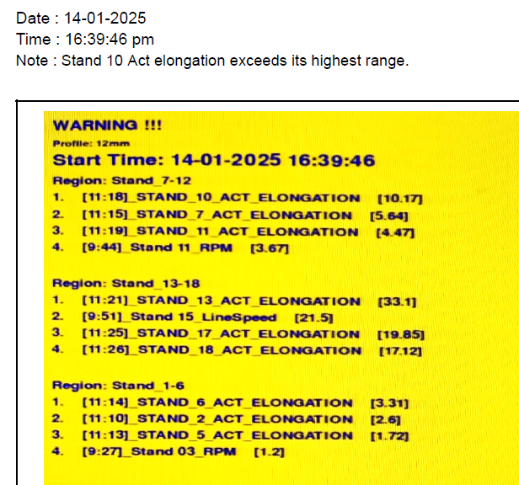
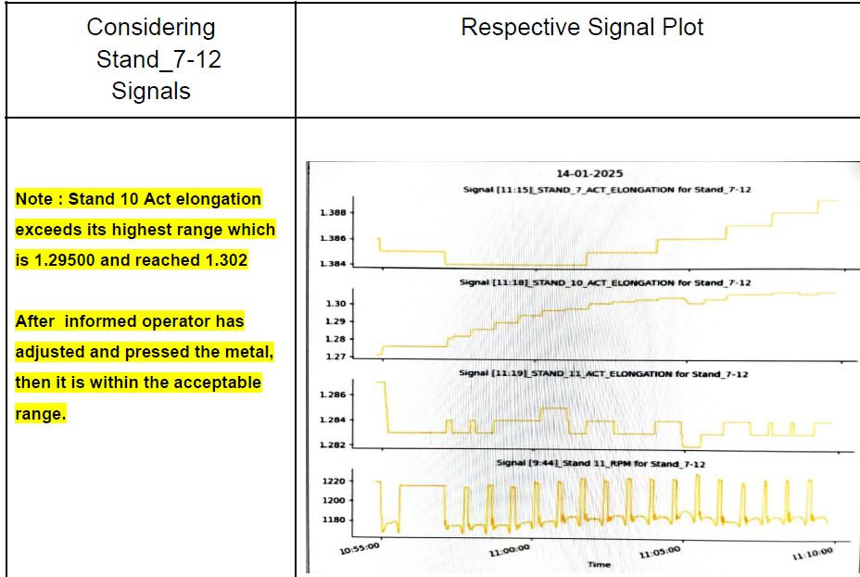
Case studies: Elongation

Slide 23
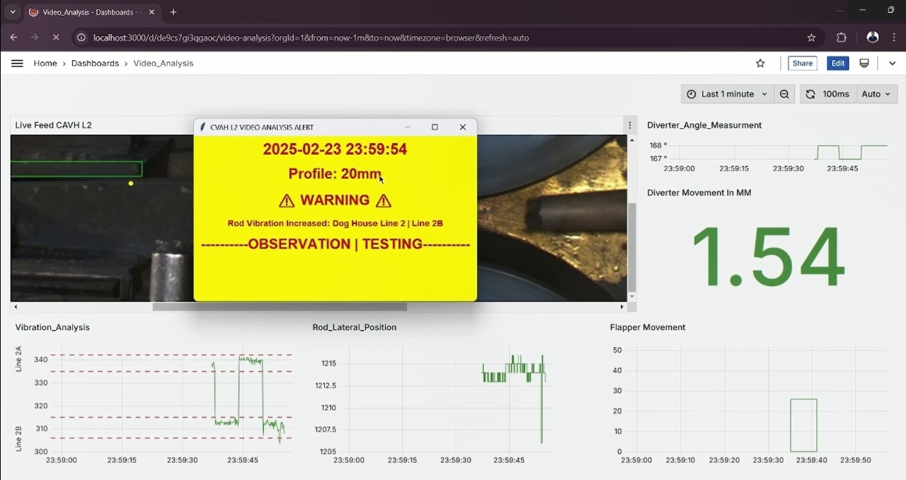
Video analysis
Video analysis.mp4 L2 Dividing Shear.mp4
Types of Analysis
Rod Vibration, Shift during Movement (Line: 2A to 2B)
Flapper Position Tracking
Diverter Position Movement

Slide 24
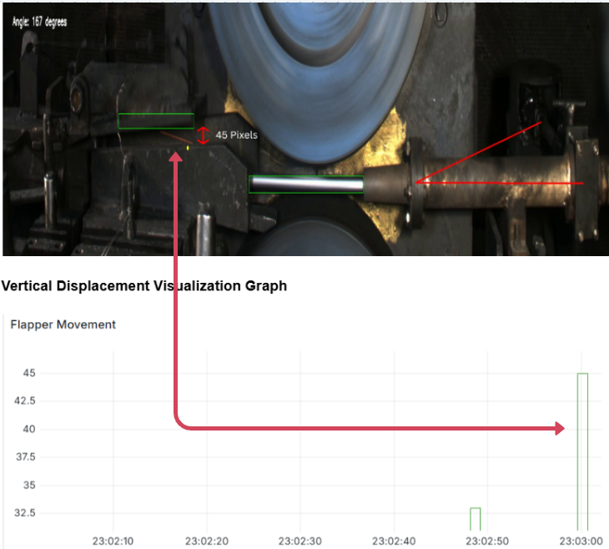
Movement Tracking: Flapper Shifted Vertically in 20 mm Profile
For the Flapper, its vertical displacement is measured relative to a static baseline:
vertical_distance=∣baseline_y−static_base_coordinates[1]|
If this distance exceeds a threshold (e.g., 30 pixels), the system flags significant movement.
The static reference point and displacement threshold allow consistent monitoring across frames.
The static reference point is marked in yellow.

Slide 25
Diverter Alignment and Angle Calculation
The diverter is represented by three key points: A, B, and C.
Detected coordinates for these points are used to draw lines connecting B → C → A.
Angles between these lines are calculated using vector mathematics:

Slide 26
Case Study 1: Overshoot (L2)

Slide 27
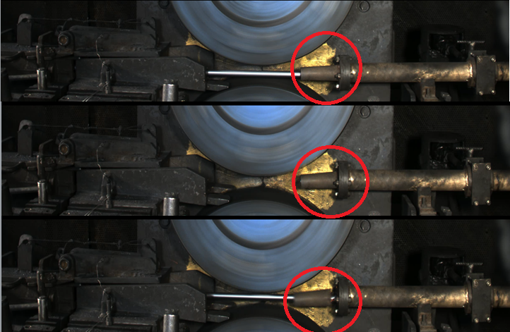
Case Study 2: Cobble due to broken funnel

Slide 28
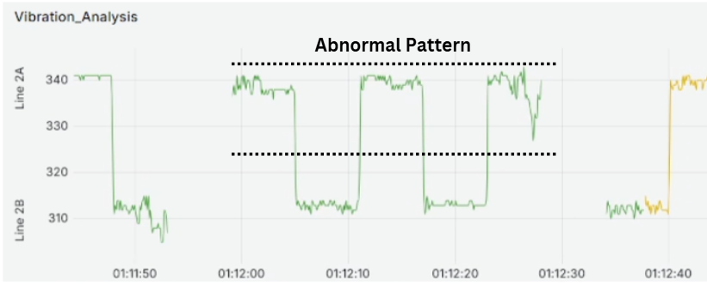
Case Study 2: Cobble due to broken funnel
Date & Time: 01.02.2025 | 12:35 PM
Location: Dog House L2
Issue: Diverter funnel dislodged
Video Analysis:
12:29 PM: Funnel tilted
Rod collision occurred
Increased vibrations
Image 1: Normal 20mm profile
Image 2: Abnormal misalignment

Slide 29
Our journey so far…

Slide 30
Failure prevention trend

Slide 31
Thank you.

